Slide 1
Software Design and Analysis
CS-3004
Lecture# 12
Dr. Javaria Imtiaz,
Mr. Basharat Hussain,
Mr. Majid Hussain

Slide 2
Outline
Package Diagram
Component Diagram
Deployment Diagram
Activity Diagram

Slide 3
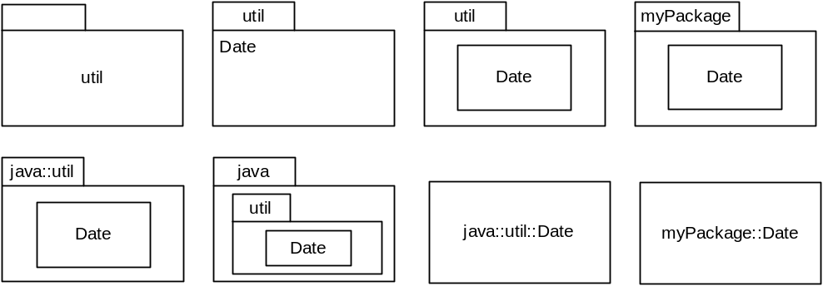
Packages

Slide 4
Package
Classes are basic structural units in an OO system
In large systems with hundreds of classes, need to group the (related) classes together into packages
A package in UML can be a collection of any packageable UML elements but it is most commonly a collection of classes
A package may contain other packages (subpackages)
A package in UML corresponds to a package in Java or a namespace in C++
Each package is a namespace
  There must never be more than one class within a package with any given name
  Classes in different packages can have the same name
If several teams working on project, each could work on a different package
  Would mean they don’t have to worry about name clashes
To distinguish between classes with the same name in different packages, use fully qualified name
  e.g., java::util::Date, myPackage::Date
UML package icon is a tabbed folder
  Can show just name or contents too
    If just name shown, then can be written in the middle of the icon, otherwise name written on tab
  Can show all details of class or even class diagram within package
  At other extreme, can just list names of classes within the package icon

Slide 5
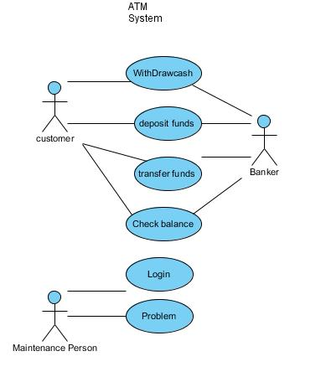
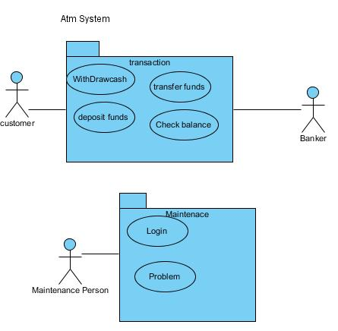
Use Case Package Diagram:
Use case Diagram ➔➔
Use case Package Diagram

Slide 6
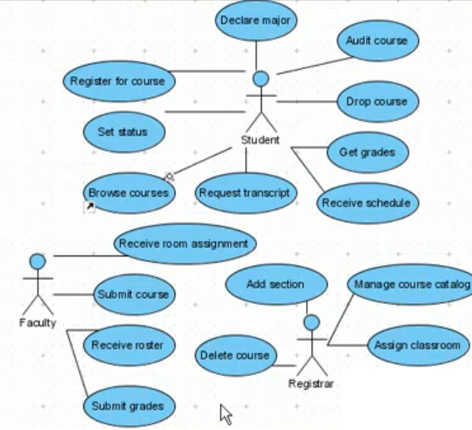
Use Case Package Diagram:

Slide 7
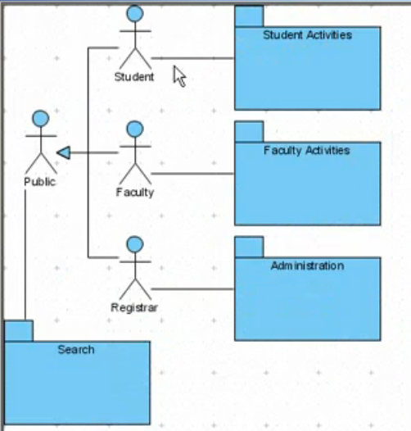
Use Case Package Diagram:

Slide 8
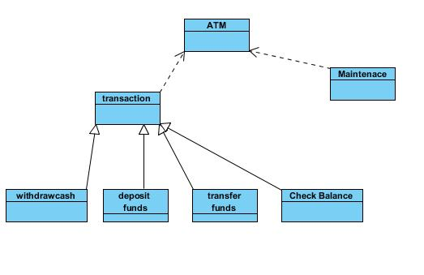
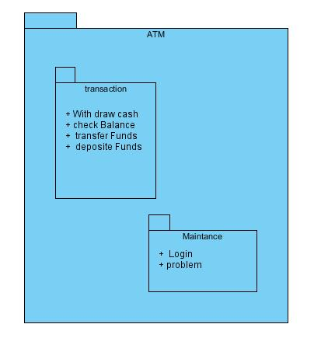
Class Package Diagram
class Diagram ➔➔
class Package Diagram

Slide 9
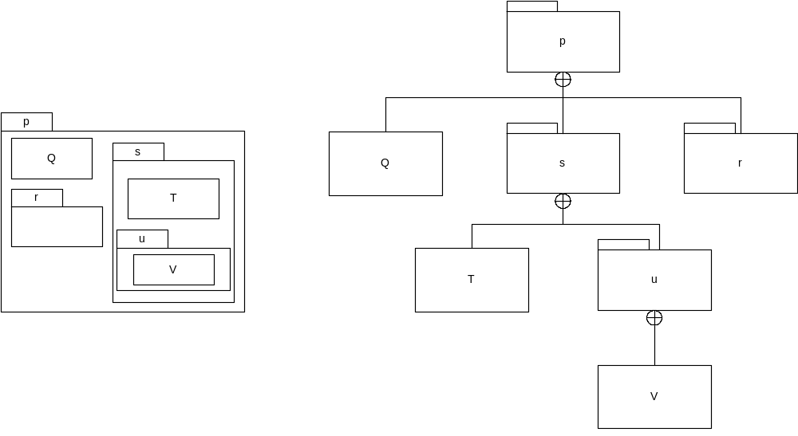
Package membership
These diagrams convey the same information

Slide 10
Class visibility and facades
Classes inside a package can be public or private
  Indicate by preceding class name with + or -, respectively
Public class is part of package’s public interface
  Can be used by classes in other packages
Private class is hidden within package
  Can only be used by other classes within the package
Can control access to a package by making all classes private and then adding special, public façade classes that delegate public operations to the private classes within the package

Slide 11
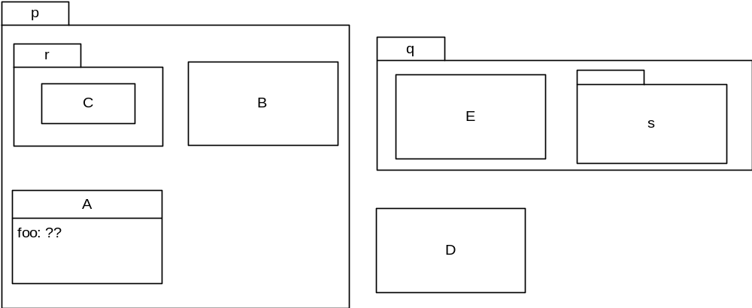
Relationships between packages
Element can refer to other elements that are in its own package and in enclosing packages without using fully qualified names.
Element x must use fully qualified name to access element in package that does not contain x.
foo can be of class B or D?
foo can be of class q::E or r::C
Notes:
foo can be of class B or D ?
B.Foo >> foo can be of type B if B is accessible within p; which is the case. Use B without any access restrictions (assuming B is public or package-private whatever).
D.Foo >> foo can be of type D if D is (a) publicly available from q and (b) is properly imported into p.
foo can be of class q::E or r::C ?
Class q::E >> Since A and E are in different packages. If (a) E is publicly accessible and (b) imported into p.
Class r::C >> Since C is in package r, which is nested within p. foo in class A can be of class of type r::C if C is accessible from p. A can use C directly if C is visible (e.g., public or package-private in r when r is also visible to p).

Slide 12
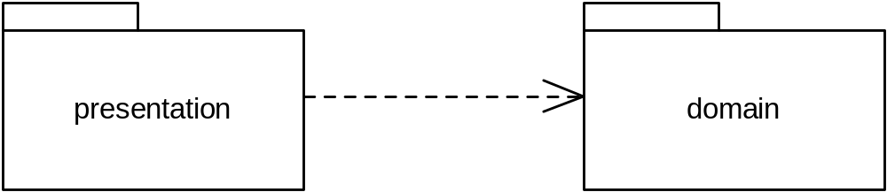
Packages and dependencies
Package diagram shows packages and their dependencies
Package A depends on package B if A contains a class which depends on a class in B.
  Inter-package dependencies summarise dependencies between classes

Slide 13
Package import
Element import identifies an element in another package and allows the element to be referenced using its name without a qualifier.
Element import indicated by dashed arrow with open arrowhead from importing package to imported element and labelling arrow with
  Keyword <<import>>, if visibility of imported element within importing package is public and
  Keyword <<access>>, if visibility of imported element within importing package is private
Import: Indicates that functionality has been imported from one package to another.
Access: Indicates that one package requires assistance from the functions of another package.

Slide 14
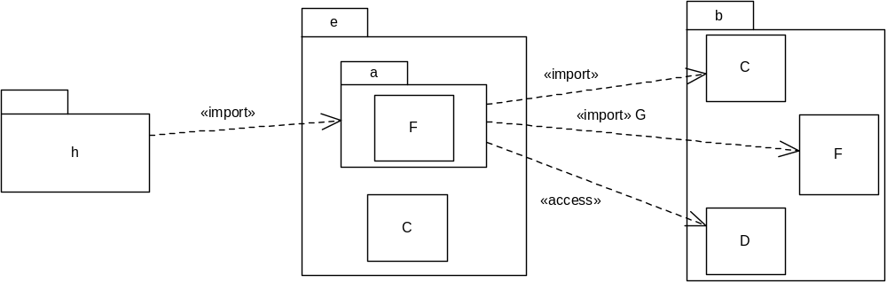
Element import
In above example
Class b::C is referred to as just C in package a, and has public visibility within package a
Imported class C hides outer class e::C which must be referred to by its fully qualified name (before import, C referred to e::C in package a)
Class b::F is imported into package a, but there is already a class called F in a, therefore cannot import b::F without aliasing it
  Class b::F is referred to as G in package a
Imported class b::D can be referred to as D in package a, and has private visibility within package a
Package h imports package a which means that, in h, b::C is referred to as C and b::F is referred to as G
  b::D is not accessible from h because its visibility in a is private

Slide 15
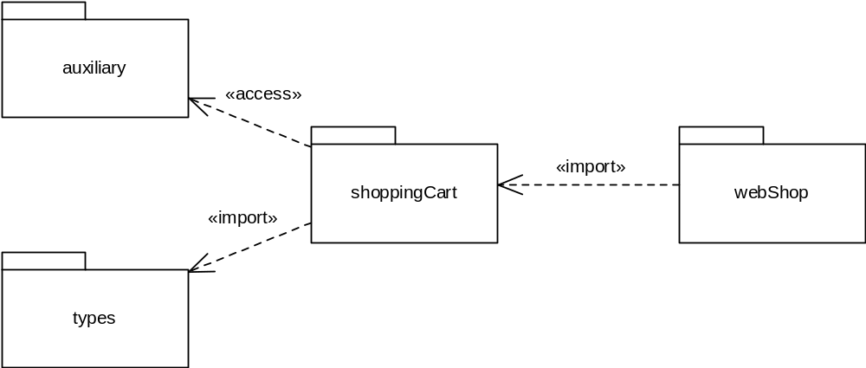
Package import
A package import is a directed relationship that identifies a package whose members are to be imported by a namespace (package)
Importing namespace adds names of members of imported package to its namespace
Conceptually equivalent to having an element import to each individual member of the imported namespace
Notated using dashed line with open arrowhead from importing namespace to imported package, labelled with keyword
  <<import>> if package import is public and
  <<access>> if package import is private
If package import is public, then imported elements will be visible outside of importing package, while if it is private, they will not be visible
In example above, elements in types are imported to shoppingCart and then further imported to webShop
But elements of auxiliary only accessible from shoppingCart, not webShop

Slide 16
Components
UML defines a component to be
  “a modular unit with well-defined interfaces that is replaceable within its environment” (UML Superstructure Specification, v.2.0, Chapter 8)
Component-based design emphasises reuse
  Component is an autonomous unit within a system
Component defines its behaviour in terms of provided and required interfaces
  A component may be replaced with another if they both provide and require the same interfaces
In UML, a component is a special type of class
  However, a component will often be a collection of collaborating classes
A component can therefore have attributes and operations and may participate in associations and generalizations
A component provides interfaces that it realizes and exposes to its environment
A component may require interfaces from other components in its environment in order to be able to provide all its functionality
External or “Black box” view on a component considers its publicly visible properties and operations
Internal or “White box” view on a component considers its private properties and realizing classifiers (i.e., the classes and other elements inside the component) and shows how the behaviour of the component is realized internally

Slide 17
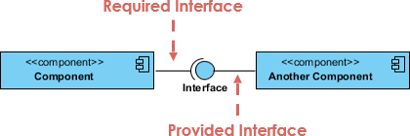

Slide 18
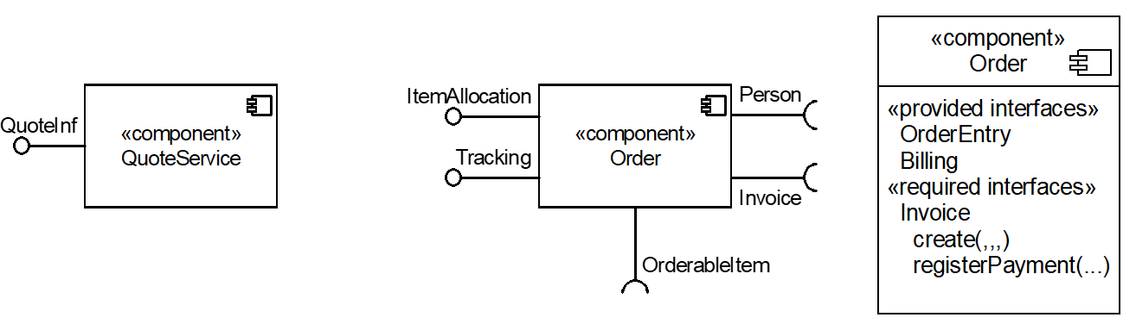
Component notation
Component icon is a class icon with the keyword <<component>>
  Optionally can include a component icon in the top, right-hand corner
Black-box view shows only interfaces provided and required either using “ball-and-socket” notation or listed in a compartment of the component rectangle

Slide 19
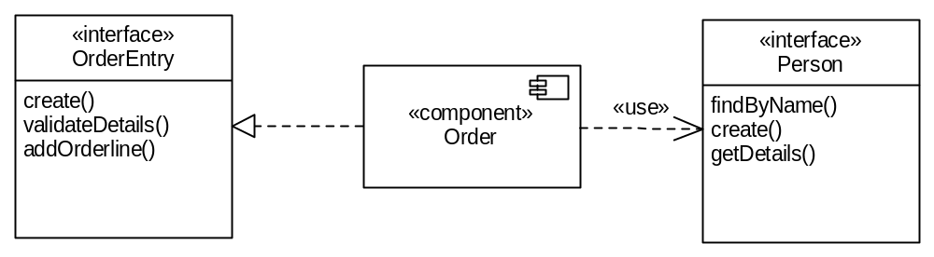
Internal, white-box view on components
Interfaces can also be displayed in full using class icons, use
  Dashed arrow with white triangle head for provided interfaces and
  Dashed arrow with open arrowhead with keyword <<use>> for required interfaces

Slide 20
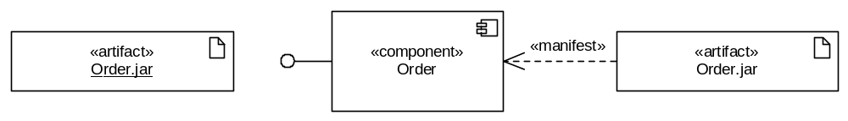
Artifacts
An artifact is a concrete element in the physical world
An artifact is the specification of a physical piece of information such as a binary executable, a database table or an implemented component such as a DLL or a Java class file
Each artifact has a filename
An artifact is represented by a normal class rectangle with the keyword <<artifact>> or an artifact icon in the top right corner
Name of artifact may (optionally) be underlined
Artifact is said to manifest model elements that are used to construct the artifact
  Manifestation indicated by dependency arrow with keyword <<manifest>>

Slide 21
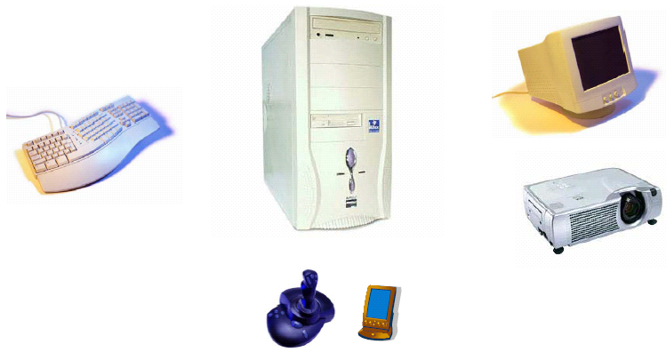
Component Diagram – another example
(www.cs.tut.fi/tapahtumat/olio2004/richardson.pdf)

Slide 22
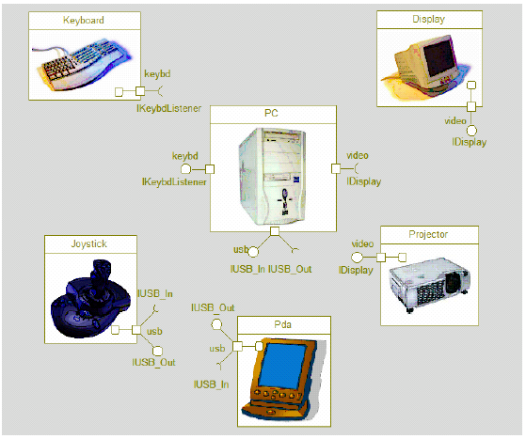
Component Diagram – another example
(www.cs.tut.fi/tapahtumat/olio2004/richardson.pdf)

Slide 23
What is a Deployment Diagram?
Deployment Diagram – a diagram that shows the physical relationships among software and hardware components in a system
  Components – physical modules of code
  Connections – show communication paths
  Dependencies – show how components communicate with other components
  Nodes – computational units, usually a pieces of hardware
A deployment diagram is a UML diagram type that shows the execution architecture of a system, including nodes such as hardware or software execution environments, and the middleware connecting them.

Slide 24
A deployment diagram is a UML diagram type that shows the execution architecture of a system, including nodes such as hardware or software execution environments, and the middleware connecting them.
Deployment diagrams are typically used to visualize the physical hardware and software of a system.
The term Deployment itself describes the purpose of the diagram. Deployment diagrams are used for describing the hardware components, where software components are deployed. Component diagrams and deployment diagrams are closely related.

Slide 25
Purpose
Component diagrams are used to describe the components and deployment diagrams shows how they are deployed in hardware.
UML is mainly designed to focus on the software artifacts of a system. However, these two diagrams are special diagrams used to focus on software and hardware components.
Most of the UML diagrams are used to handle logical components but deployment diagrams are made to focus on the hardware topology of a system. Deployment diagrams are used by the system engineers.

Slide 26
The purpose of deployment diagrams can be described as −
  Visualize the hardware topology of a system.
  Describe the hardware components used to deploy software components.
  Describe the runtime processing nodes.

Slide 27
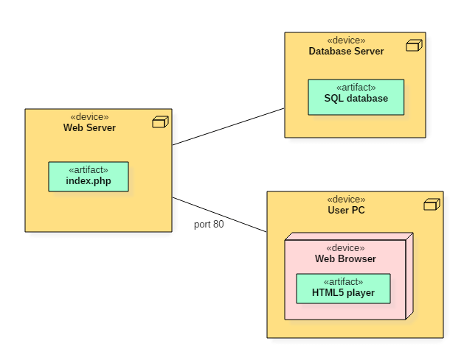

Slide 28
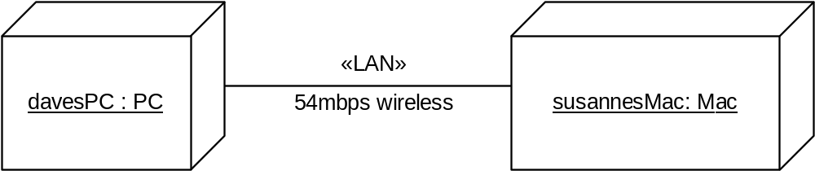
The physical layer
Deployment diagram shows
  The physical communication links between hardware items (nodes) (e.g., pcs, printers)
  The relationships between physical devices (nodes) and processes (artifacts)
Physical layer consists of the machines, represented by nodes, and the (physical) connections between them (e.g., cables), represented by associations
Nodes have node types

Slide 29
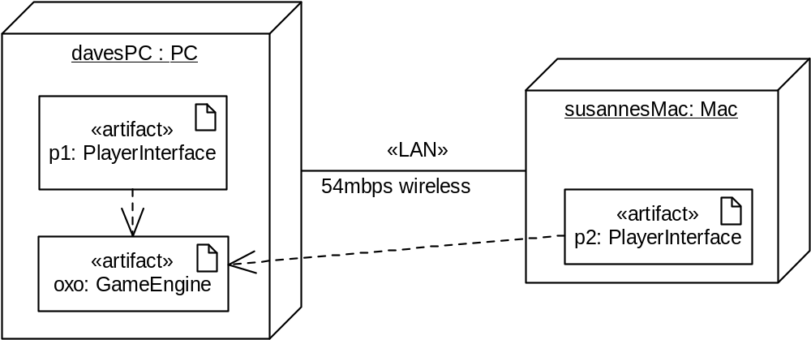
Deploying the software artifacts on the hardware nodes
Artifact shown inside a node to show that it runs on the node
If an artifact depends on another artifact then there must be a physical link between the nodes on which they are deployed

Slide 30
Deployment Diagram
Shows a set of processing nodes and their relationships.
Represents the static deployment view of an architecture.
Nodes typically enclose one or more components.
TCP/IP
IIS + PhP Server
TCP/IP
J2EE Server
Membership Server
DecNet
Tomcat Server

Slide 31
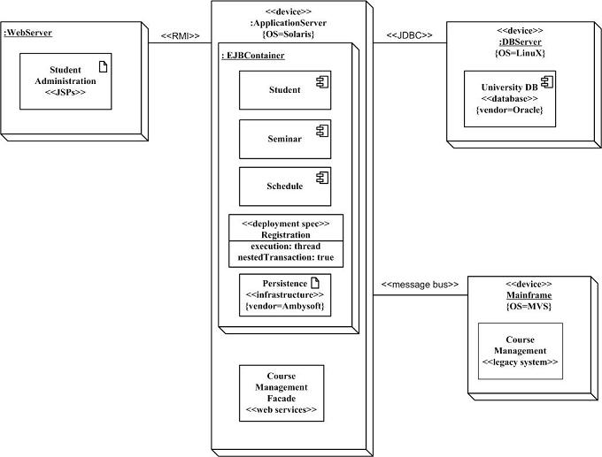
Structural Diagrams - Deployment Diagram
(http://www.agilemodeling.com/artifacts/deploymentDiagram.htm)
Student administration application
Physical nodes - stereotype device
WebServer - physical device or software artifact
RMI/message bus: connection type
Nodes can contain other nodes or software artifacts recursively
Deployment specs: configuration files: name and properties

Slide 32


Activity Diagrams
Fancy flowchart
  Displays the flow of activities involved in a single process
  States
    Describe what is being processed
    Indicated by boxes with rounded corners
  Swim lanes
    Indicates which object is responsible for what activity
  Branch
    Transition that branch
    Indicated by a diamond
  Fork
    Transition forking into parallel activities
    Indicated by solid bars
  Start and End

Slide 33
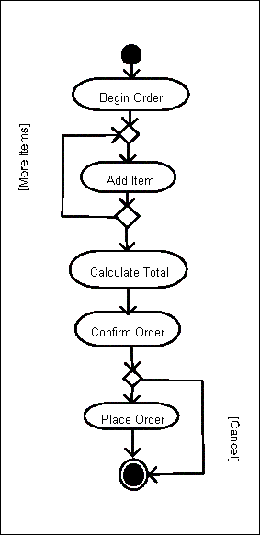
Sample Activity Diagram
Ordering System
May need multiple diagrams from other points of view

Slide 34

Activity Diagram Example

